Slide 1

Classroom Grade Composition and Pupil Achievement
By Edwin Leuven & Marte Ronning
Present:
Paul Navas
Maria del Socorro Padilla

Slide 2
Presentation outline
Question
Channels considered
Source of variation
Research design
Identifying assumptions
Inference
Results
Comments

Slide 3
Question
How does classroom grade composition affect student achievement?
  Is it more beneficial to be in combination classes than in single grade classrooms?

Slide 4
Channel
Negative or positive spillovers due to the presence of more or less able peers since pupil’s grade is correlated with her age and length of schooling, and therefore with cognitive development and achievement.
Peers from higher grades can serve as role models in terms of non-academic behavior, which can feedback to school achievement
Classroom’s grade composition can also significantly affect teacher inputs and teaching methods

Slide 5
Previous research
Fixed effects studies -->Within school or grade variation in peers characteristics
    This strategy is compromised if pupils are not randomly allocated to peers and teachers.
    Usually little variation in peer group composition
Experiments
Quasi-experiments
Selection on observables

Slide 6
Threats
Omitted variable bias
Measurement error
Grade mixing arises when school’s grade mixing in year t depends on the perceived success of grade mixing in year t-1

Slide 7
Contribution
Identification and addressing confounding effects.
        Previous papers have struggled to address potential negative spillovers of grade mixing to other single grade class rooms, and the confounding effects of class size. An important aspect of our study is that the first issue does not arise in our setup, and that we can control for and, more importantly, instrument for class size.
They can separate the average effect of grade mixing into that of sharing the classroom with lower grades vs higher grades.
They can control and instrument for class size

Slide 8
Source of variation
Discontinuous grade mixing rules in Norwegian junior high schools

Slide 9
Data
Integrated schools that manage both primary and junior high school level.
Those schools are relatively small and remote, it is common practice to combine multiple grades in a single classroom.
All junior high schools in Norway follow the same national curriculum
All junior high schools teachers are required to have completed teacher college

Slide 10
Mixed data sets contain
Administrative enrollment data on all pupil’s who graduated from junior high school 2001/02 and 2002/03
Grade mixing
Number of pupils and classes per grade
Pupil’s birth date and gender
Socioeconomic characteristics
Test-score

Slide 11
Maximum class size rules
A class in junior high school cannot have more than
  18 pupils when there are three cohorts in the class
  24 pupils when there are two cohorts in the class
  30 pupils when there is one cohort in the class

Slide 12
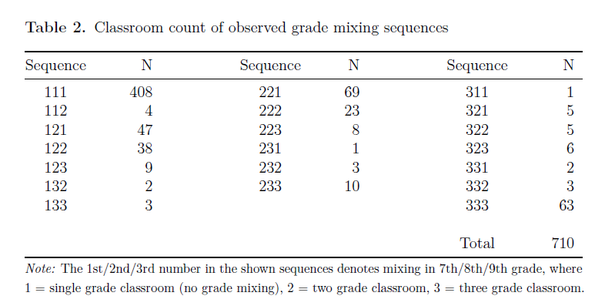
Data

Slide 13
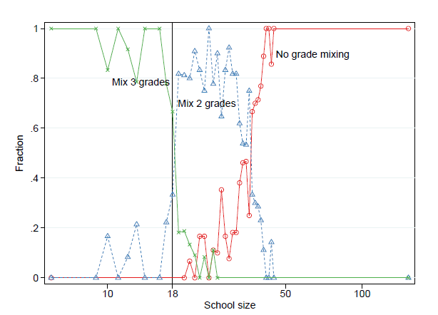
Average number of grades mixed by school size
Notes:
illustrates the contemporaneous relationship between school size and multiple grade classrooms in 9th grade generated by the institutional setup

Slide 14
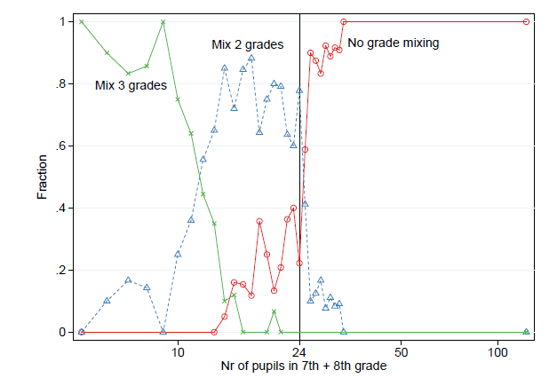
Average number of grades mixed by cohort size of 7th and 8th graders
Notes:
Schools are supposed to combine two grades when either the combined enrollment of 7th and 8th grade, or the combined enrollment of 8th and 9th grade drops below 24. These rules are illustrated in Figures 1b and 1c. We again see sharp drops in the incidence, this time of double grade classrooms.

Slide 15
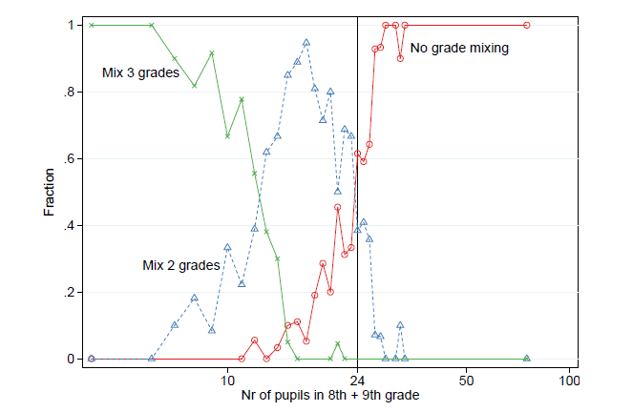
Average number of grades mixed by cohort size of 8th and 9th graders
Notes:
Schools are supposed to combine two grades when either the combined enrollment of 7th and 8th grade, or the combined enrollment of 8th and 9th grade drops below 24. These rules are illustrated in Figures 1b and 1c. We again see sharp drops in the incidence, this time of double grade classrooms.

Slide 16
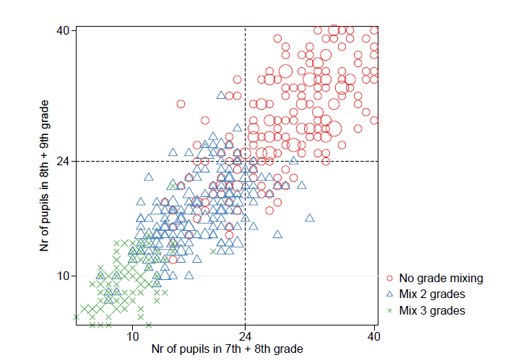
The interaction of grade mixing rules -9th grade enrollment
Notes:
shows actual grade mixing as a function of the relevant cohort sizes.

Slide 17
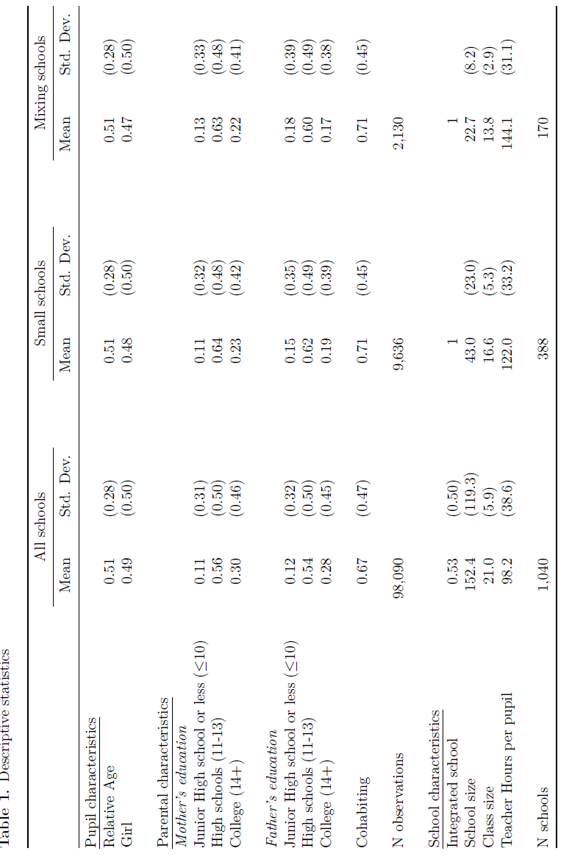

Slide 18
Research design
Instrumental variable approach
    They instrument observed grade mixing with predicted grade mixing based on institutional rules.
  They don’t use regression discontinuity because they do not have enough observations.

Slide 19
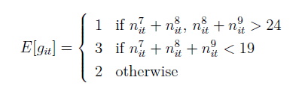
Predicted grade mixing
    n^{j}_{it} is the number of students in class n in grade j at time t for pupil i
Notes:
This conditions correspond to the official rules, also illustrated by figures 1 and 2.

Slide 20

Predicted Class Size
    n^{j}_{it} is the number of students in class n in grade j at time t for pupil i

Slide 21
Identifying Assumptions
Relevance condition:
    Predicted grade mixing is correlated with observed grade mixing
Exclusion restriction:
    The only effect the predicted grade mixing can have on the pupil achievement is through its effect on observed grade mixing.

Slide 22



First and second stage equations
School size
School and family control variables
Average number of grade levels a pupil was exposed during high school
Pupil achievement at the end of high school
Average number of higher grade level’s in pupil’s classroom when he was in high school

Slide 23
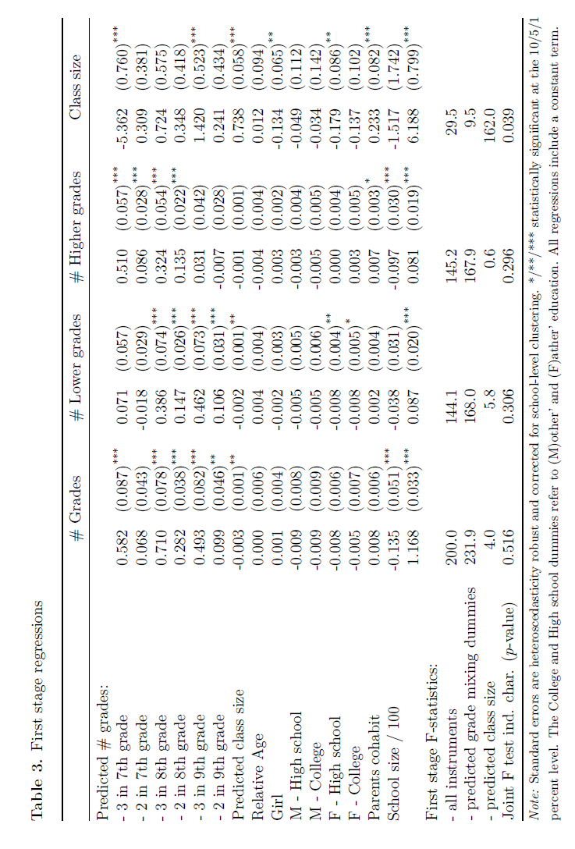
Relevance condition

Slide 24
Exclusion restriction
check whether parents and/or schools position themselves in non-random ways around the points where schools are supposed to change the classroom grade composition.
  Parents prefer mixing or non-mixing classrooms they might decide to enroll their children in a different school.
    If more advantaged families sort in different ways than disadvantaged families, the underlying pupil population at both sides of the discontinuities are not longer comparable.
    Families moving to different school catchment areas in reaction to our anticipating classroom grade composition.

Slide 25
Exclusion restriction
Check alternative confounding changes of related school inputs
  Class-size discontinuously changes when combining grades
    Combining grades not only changes the classroom grade composition but also class-size.
  Grade mixing in junior high school could be correlated with grade mixing in primary school.

Slide 26
Inference
Standard errors are clustered at school-level

Slide 27
Results
Pupils in combination classes perform slightly better than homogeneous single grade classrooms.
  Driving by pupils benefiting from sharing the classroom with more mature peers from higher grades.
The presence of lower grade peers decreases achievement
  Effects are larger on girls
Class size does not have an effect on student achievement.

Slide 28
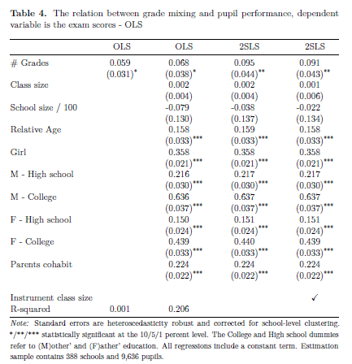

Slide 29
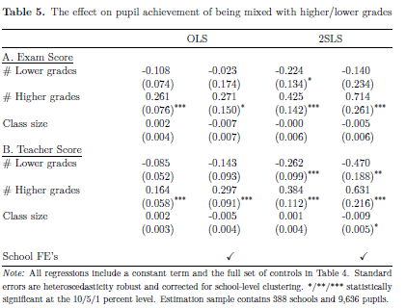

Slide 30
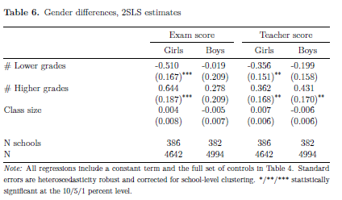

Slide 31
Comments
Potential endogeneity of the instrument: There may be factors affecting the instrument and the outcome:
  The composition of the mixed grades under the control of school authorities. This confounding is not addressed.
  The quality of the teachers assigned to mixed classes: more experienced teachers may be sent to mixed classed because they can handle it better, but no way to control for this

Slide 32
Comments
Classroom grade composition in previous education
  Mixing also takes place before 7th grade, so there may be a learning curve or other dynamic aspect of the effect not taken into account here.
Sample selection
  It is possible that individuals who left the sample have specific characteristics that could bias our estimates.

Slide 33
Comments
Sample
  The sample is concentrated in rural areas, and there may be some sorting into urban areas to avoid mixing.
Fixed effects at the province level
Heterogeneity in observed characteristics
  In Table 1 it seems to be differences in observed characteristics that might be misleading their estimates.

Slide 34
Comments
Instruments:
  Class size
    the authors assume that the mixing between 7th-8th and 8th-9th happen with probability 0.5. But when we see the observed mixing sequences in table 2 this probability does not match.
  Predicted grade mixing
    The predicted grade composition of a student who was mixed in 9th grade with 7th and 8th graders is the same as the one of a student who was mixed in 7th grade with 8th graders and 8th grade with 9th graders.
    No weighting in construction of indicators: is mixing the same if in 7th-8th as in 8th-9th?

